Slide 1
Laboratory in Secure Computation in the Cloud Adi Akavia University of Haifa, Fall 2019
Privacy-preserving machine learning SVM inference on FHE encrypted data

Slide 2
Presenting Students Details
Gal Savranevski

Slide 3
Tasks
Train SVM model on cleartext data.
Design an arithmetic circuit
Implement inference with your SVM model on FHE encrypted data
Write a report

Slide 4
References and Resources
List here the resources you used:
Books
Video lectures and slides
Other material you use
Further reading recommendations (good resources you encountered in your studies and recommend for other students)

Slide 5
Additional Instructions
Name your pptx file “x-y”, where for
x = lecture number (2-13)
y = lecture topic (the words in bold font in the “What” column of the Topics and Schedule table).
Form & Language:
Slides must be in English
Oral presentation should be in Hebrew.
Illustration & animation are essential tools (but don’t overdo for “show-off”!)
Text should be concise. Reading long text is impossible.
Emphasize text using colors, italic, bold (or their combination):
Use red and blue as primary colors for emphasizing and highlighting important text; Additional colors allowed when needed.
Use italic font to emphasize new terms you are defining, use bold for other emphasis.

Slide 6
Machine Learning and SVM
Machine Learning basics
Supervised / Unsupervised learning
Different ML Algorithms
Dataset , features , target variable
Data : different types , data proccessing
Model Evaluation (Confusion matrix, Score)
SVM
Theory
Optimization problem : SVM finds the widest street between the nearest points on either side.
Hyper plane
Hard margin / Soft margin
Support vectors
Kernel Trick

Slide 7
Machine Learning and SVM Tools
Phyton
SciKit
Editors
Phycharm
Jupyter notebook
Finding a dataset
Google
Kaggle
UC Irvine Machine Learning Repository

Slide 8
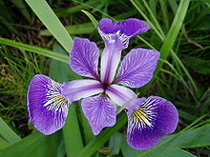
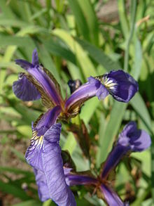
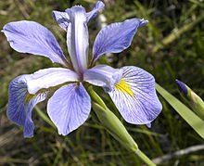
Dataset
Start simple
Iris data set
150 records ,5 attributes ( 4 features , 1 target)
3 classes (reduced to 2)
Perfect linear/polynimial seperable
Classify Iris Spices : setosa , versicolor , virginica

Slide 9
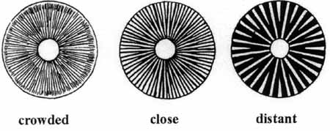
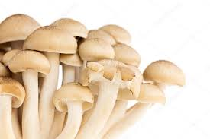
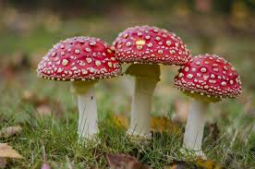
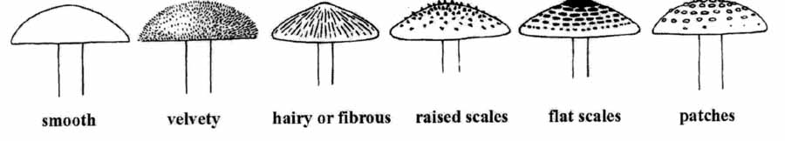
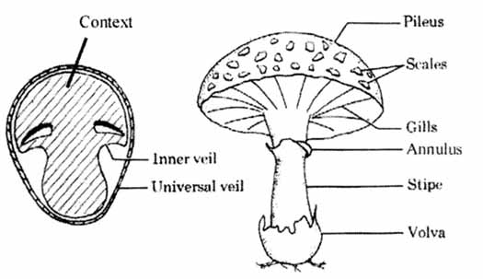
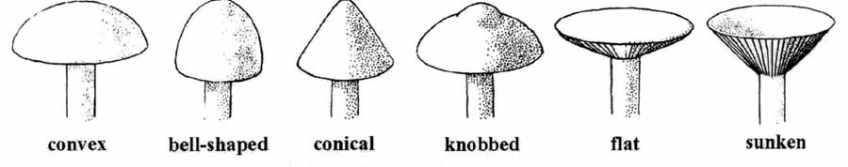
Dataset
Large dataset
Mushroom Classification
8124 records , 23 attributes ( 4 features , 1 target)
2 classes : edible , poisonous
Perfect polynimial seperable (d=2)

Slide 10
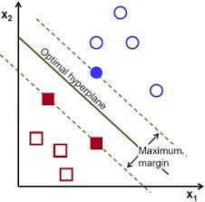
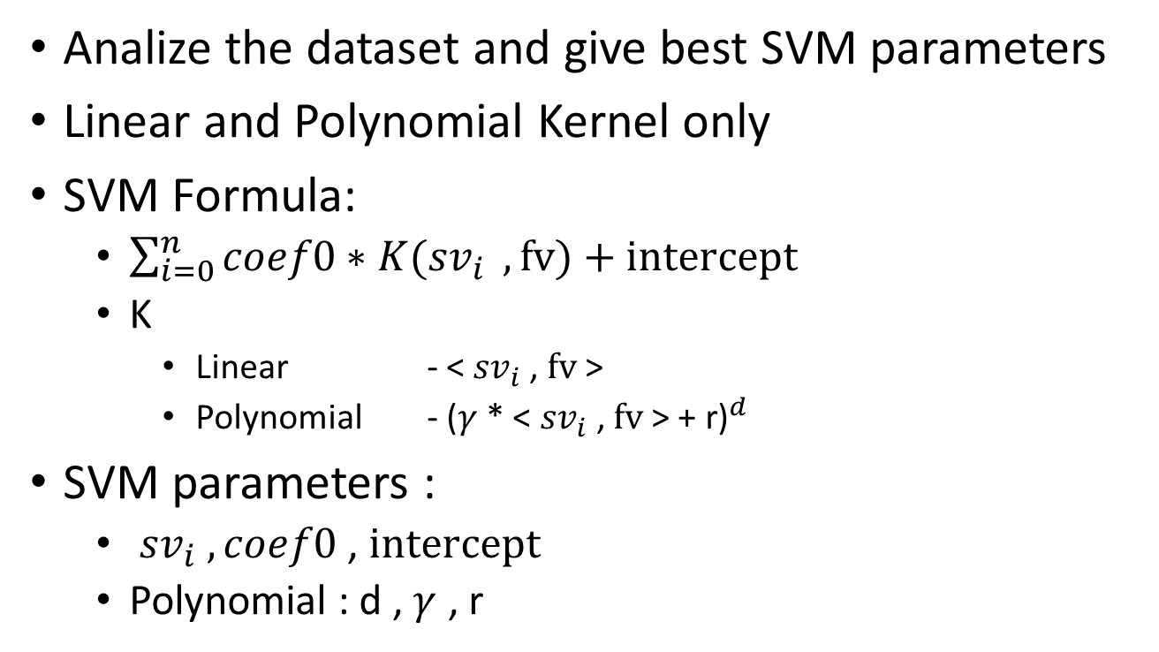
SVM
Analize the dataset and give best SVM parameters
Linear and Polynomial Kernel only
SVM Formula:
$\sum_{i=0}^{n}{coef0∗K({sv}_{i}} , fv)+intercept$
K
Linear - < ${sv}_{i}$, $fv$>
Polynomial - ${\text{(}γ\text{ * < }{sv}_{i} \text{, }fv \text{> + }\text{r}\text{)}}^{d}$
SVM parameters :
${sv}_{i} , coef0$ , $intercept$
Polynomial : d , $γ$ , r

Slide 11
Fully homomorphic encryption
Homomorphic encryption is a form of encryption that allows computation on ciphertexts, generating an encrypted result which, when decrypted, matches the result of the operations as if they had been performed on the plaintext.
Useful for secure outsourcing supporting protection of data-in-use

Slide 12
SEAL
C#
Setup
Examples
Performance

Slide 13
HE
Five stages
Setup
Scheme
Security parameters
Functionality parameters
Key generation
Secret key, Public key, Relinearization key, Galois keys
Encryption
A number or a vector of numbers → A cipher text
Evaluation
Decryption

Slide 14
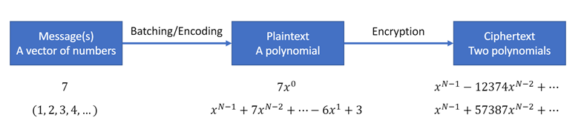
SIMD Computation
N = PolyModulusDegree ; (8192 , 16384)
Encrypted cipher text has N/2 slots (‭4096‬ , 8192)
Enc(1,2,3,…) + Enc(1,2,3,…) = Enc(2,4,6,…)
Enc(1,2,3,…) x Enc(1,2,3,…) = Enc(1,4,9,…)

Slide 15
CKKSEncoder
CKKSEncoder
scheme for computing on encrypted real or complex numbers
To create CKKS plaintexts we need a special encoder: there is no other way to create them
In CKKS the number of slots is
PolyModulusDegree / 2
each slot encodes one real or complex number
The floating-point coefficients of `input’ will be scaled up by the parameter `scale’
it is instructive to think of the scale as determining the bit-precision of the encoding

Slide 16
Evaluator
evaluator can only operate on CYPHERTEXT at same level
Relinearization , Rescale
Encrypted addition and subtraction require that the scales of the inputs arethe same, and also that the encryption parameters (ParmsId) match. If there is a mismatch, Evaluator will throw an exception.

Slide 17
Working Guidelines
Scale stabilization
Call RelinearizeInplace and rescale - after each multiplication
scale stabilization is important because :
avoid out of scaling
keeps performance same level
avoid unnecessary precision
Multiplication
the scale grows ~ scale ^2 = scales_bits*2
MaxBitCount
max bits allowed per each polinomial degree (polyModulusDegree )

Slide 18
Working Guidelines
CoeffModulus
most "problematic" feature to choose
depends on percision and calculation depth
Guideline
first prime = Choose a 60-bit prime as the first prime in CoeffModulus. This will give the highest precision when decrypting.
choose another 60-bit prime as the last element of CoeffModulus, as this will be used as the special prime and should be as large as the largest of the other primes.
Choose the intermediate primes to be close to each other
minimum bits : 2^bit_size - 2 * ntt_size(polyModulusDegree) + 1

Slide 19
Working Guidelines
ParmsId
Encrypted multiplication addition and subtraction require that the scales of the inputs are the same, and also that the encryption parameters (ParmsId) match
MultiplyPlain
Multiply by 0 is not allowed ( use 1e-9).
Rotation
Needs Galois Keys = expensive.
rotations do not consume any noise budget

Slide 20
SVM and SEAL
“Plain” SVM implementation .
IRIS
Find parameters with SCIKIT
Simple program :
no loops , custom made data struct
With / Without: Relinearizetion , rescale
Different scales (precision, performance)
Linear kernel
Generalize implementation (suitable not only for iris)
Use loops and general data structs
No SIMD
Linear kernel only
Polynomial kernel
CoeffModulus vs PolynomialDegree vs performance vs generalization ☹
First SIMD

Slide 21
SVM and SEAL
Generalize implementation
Circle Depth
Linear = 2
Plynomial = d+3

Slide 22

SVM and SEAL
FIRST SIMD
Implement IP with rotation ( $\log_{2}{\backslash \left\lceil fv\right\rceil }$ )
1 | 2 | 3 | 4 | 5 | 6 | 7 | 8
Rotate (1)
2 | 3 | 4 | 5 | 6 | 7 | 8 | 1
2 | 3 | 4 | 5 | 6 | 7 | 8 | 1
Rotate (2)
1+2 | 2+3 | 3+4 | 4+5 | 5+6 | 6+7 | 7+8 | 8+1
3+4 | 4+5 | 5+6 | 6+7 | 7+8 | 8+1 | 1+2 | 2+3
3+4 | 4+5 | 5+6 | 6+7 | 7+8 | 8+1 | 1+2 | 2+3
Rotate (4)
1..4 | 2..5 | 3..6 | 4..7 | 5..8 | 8+1 | 1+2 | 2+3

Slide 23
SVM and SEAL
Mashroom (Lets complicate)
Preprocess and Find best parameters with SCIKIT
Calculate score with SCIKIT
Run with SEAL ( or TRY to run…)
Many hours ….
Bugs in implementation
Poor Performance
POOR PERFOMANCE (20 sec per record)
16 sec for IP!!!
Try with regular IP implementation (35 sec per record)
0 in plaintext multiplication
25sec for IP
Parallel computation (use all CPUS by running many instances)
Still poor performance ☹

Slide 24
SVM and SEAL
SECOND (POWER FULL) SIMD
Apply prediction for many records
Each CiherText have N/slots
if N = 16384 ,Num of slots = 8192
Mashroom record has 22 features
So we can apply prediction for ~200(!!!) records at once (!
1 | … | 22 | 0 | .. | 0 | 1 | … | 22 | 0 | … | 0 | 1 | … | 22 | …

Slide 25
SVM and SEAL
PowerFull SIMD
The client and the server need to agree on number of concated records
Average Predict: 107 ms (without parallel processing)

Slide 26
1. cap-shape: bell=b,conical=c,convex=x,flat=f, knobbed=k,sunken=s 2. cap-surface: fibrous=f,grooves=g,scaly=y,smooth=s 3. cap-color: brown=n,buff=b,cinnamon=c,gray=g,green=r, pink=p,purple=u,red=e,white=w,yellow=y 4. bruises?: bruises=t,no=f 5. odor: almond=a,anise=l,creosote=c,fishy=y,foul=f, musty=m,none=n,pungent=p,spicy=s 6. gill-attachment: attached=a,descending=d,free=f,notched=n 7. gill-spacing: close=c,crowded=w,distant=d 8. gill-size: broad=b,narrow=n 9. gill-color: black=k,brown=n,buff=b,chocolate=h,gray=g, green=r,orange=o,pink=p,purple=u,red=e, white=w,yellow=y 10. stalk-shape: enlarging=e,tapering=t 11. stalk-root: bulbous=b,club=c,cup=u,equal=e, rhizomorphs=z,rooted=r,missing=? 12. stalk-surface-above-ring: fibrous=f,scaly=y,silky=k,smooth=s 13. stalk-surface-below-ring: fibrous=f,scaly=y,silky=k,smooth=s 14. stalk-color-above-ring: brown=n,buff=b,cinnamon=c,gray=g,orange=o, pink=p,red=e,white=w,yellow=y 15. stalk-color-below-ring: brown=n,buff=b,cinnamon=c,gray=g,orange=o, pink=p,red=e,white=w,yellow=y 16. veil-type: partial=p,universal=u 17. veil-color: brown=n,orange=o,white=w,yellow=y 18. ring-number: none=n,one=o,two=t 19. ring-type: cobwebby=c,evanescent=e,flaring=f,large=l, none=n,pendant=p,sheathing=s,zone=z 20. spore-print-color: black=k,brown=n,buff=b,chocolate=h,green=r, orange=o,purple=u,white=w,yellow=y 21. population: abundant=a,clustered=c,numerous=n, scattered=s,several=v,solitary=y 22. habitat: grasses=g,leaves=l,meadows=m,paths=p, urban=u,waste=w,woods=d

